Slide 1

CAP950 OPEN SOURCE TECHNOLIGIES (PHP)

Slide 2
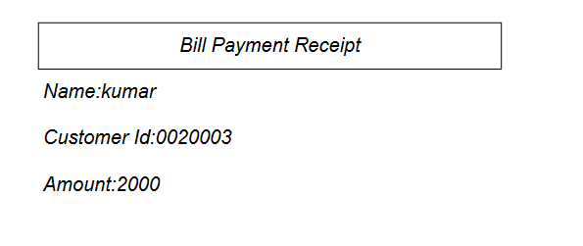

Slide 3
Create PDF file using PHP
Steps: ?

Slide 4
cell (rectangular area): Cell(100,10,’String',1,0,'C',0);
Prints a cell (rectangular area) with optional borders, background color and character string. The upper-left corner of the cell corresponds to the current position. The text can be aligned or centered. After the call, the current position moves to the right or to the next line. It is possible to put a link on the text.
Parameters
w
Cell width. If 0, the cell extends up to the right margin.
h
Cell height. Default value: 0.
txt
String to print. Default value: empty string.

Slide 5
border
Indicates if borders must be drawn around the cell. The value can be either a number:
0: no border
1: frame
or a string containing some or all of the following characters (in any order):
L: left
T: top
R: right
B: bottom
Default value: 0.

Slide 6
fill
Indicates if the cell background must be painted (true) or transparent (false). Default value: false.
link
URL or identifier returned by AddLink().

Slide 7
SetFont()
SetFont('Arial','B',14);
Font type:
Courier (fixed-width)
Helvetica or Arial (synonymous; sans serif)
Times (serif)
Symbol (symbolic)
ZapfDingbats (symbolic)
Font Style:
empty string: regular
B: bold
I: italic
U: underline
Font size: in points.

Slide 8
SetDrawColor(int r [, int g, int b])
Parameters
r
If g et b are given, red component; if not, indicates the gray level. Value between 0 and 255.
g
Green component (between 0 and 255).
b
Blue component (between 0 and 255).

Slide 9
SetFillColor
SetFillColor(int r [, int g, int b])
Description
Defines the color used for all filling operations (filled rectangles and cell backgrounds). It can be expressed in RGB components or gray scale. The method can be called before the first page is created and the value is retained from page to page.

Slide 10
<?php
$img = imagecreatetruecolor(500, 300);
$color = imagecolorallocate($img, 155, 250, 280);
imagefill($img, 0,0,$color);
header("Content-Type: image/jpeg");
imagepng($img);
?>

Slide 12
Any Query?

